Slide 1
DEMPSEY RESIDENCE
Developmental Variance Request
September 14, 2021 Public Hearing

Slide 2
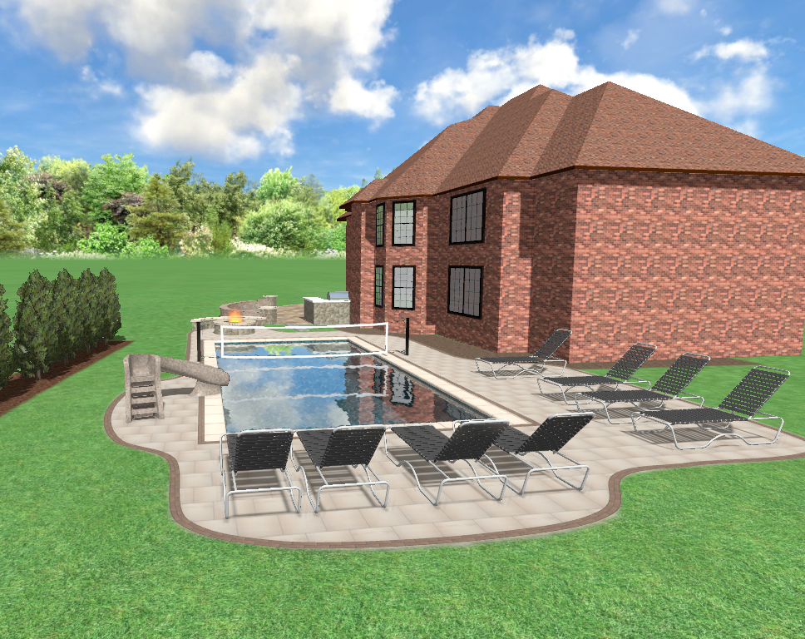
9745 Laurel Ct
Single Family Residence
Petitioner is planning to construct an inground pool with automatic cover
Section 26-159 of the Munster Municipal Code prohibits outdoor swimming pools without a fence

Slide 3
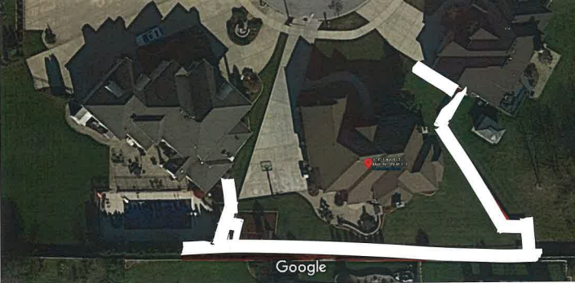

Slide 4
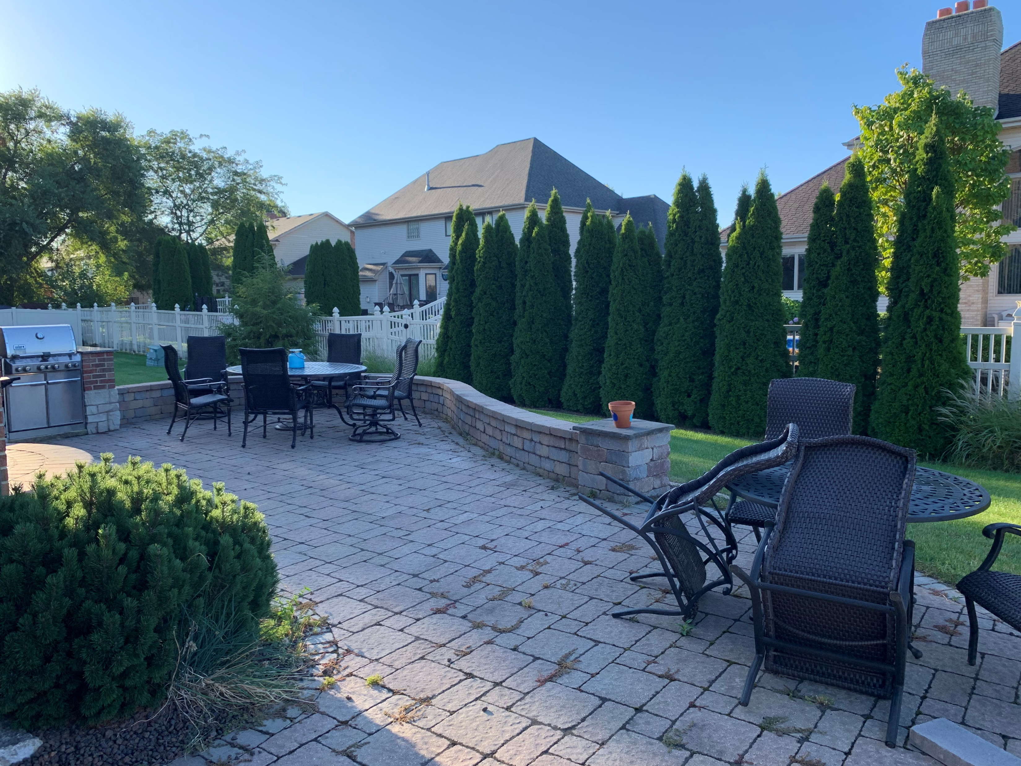

Slide 5
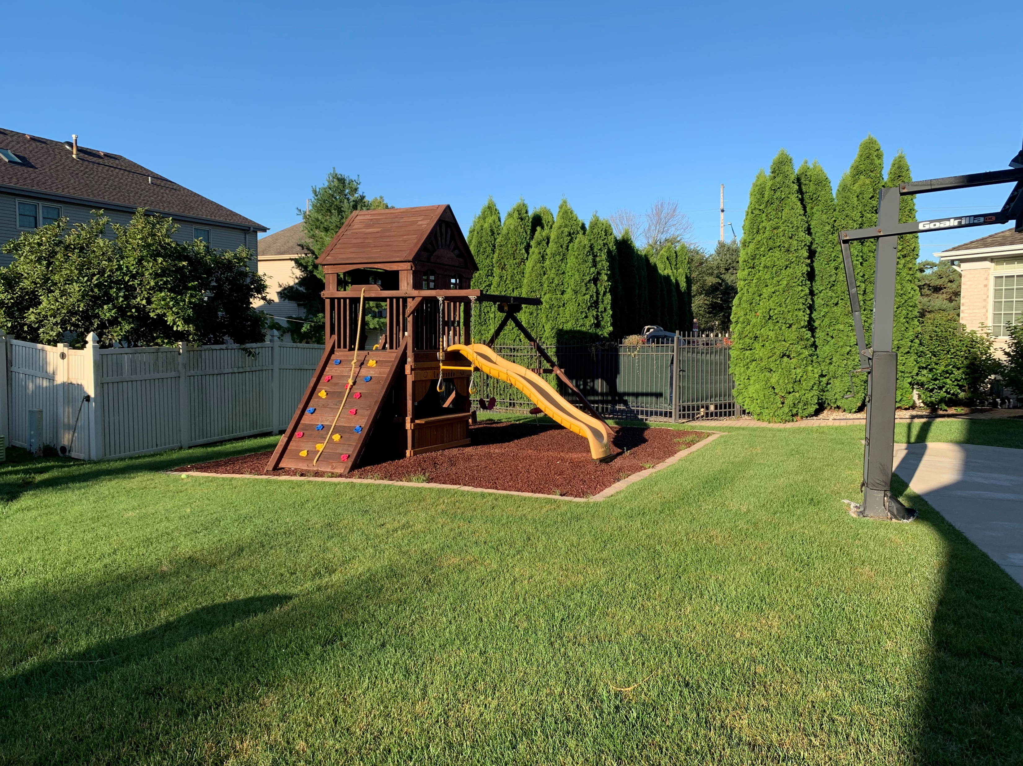

Slide 6
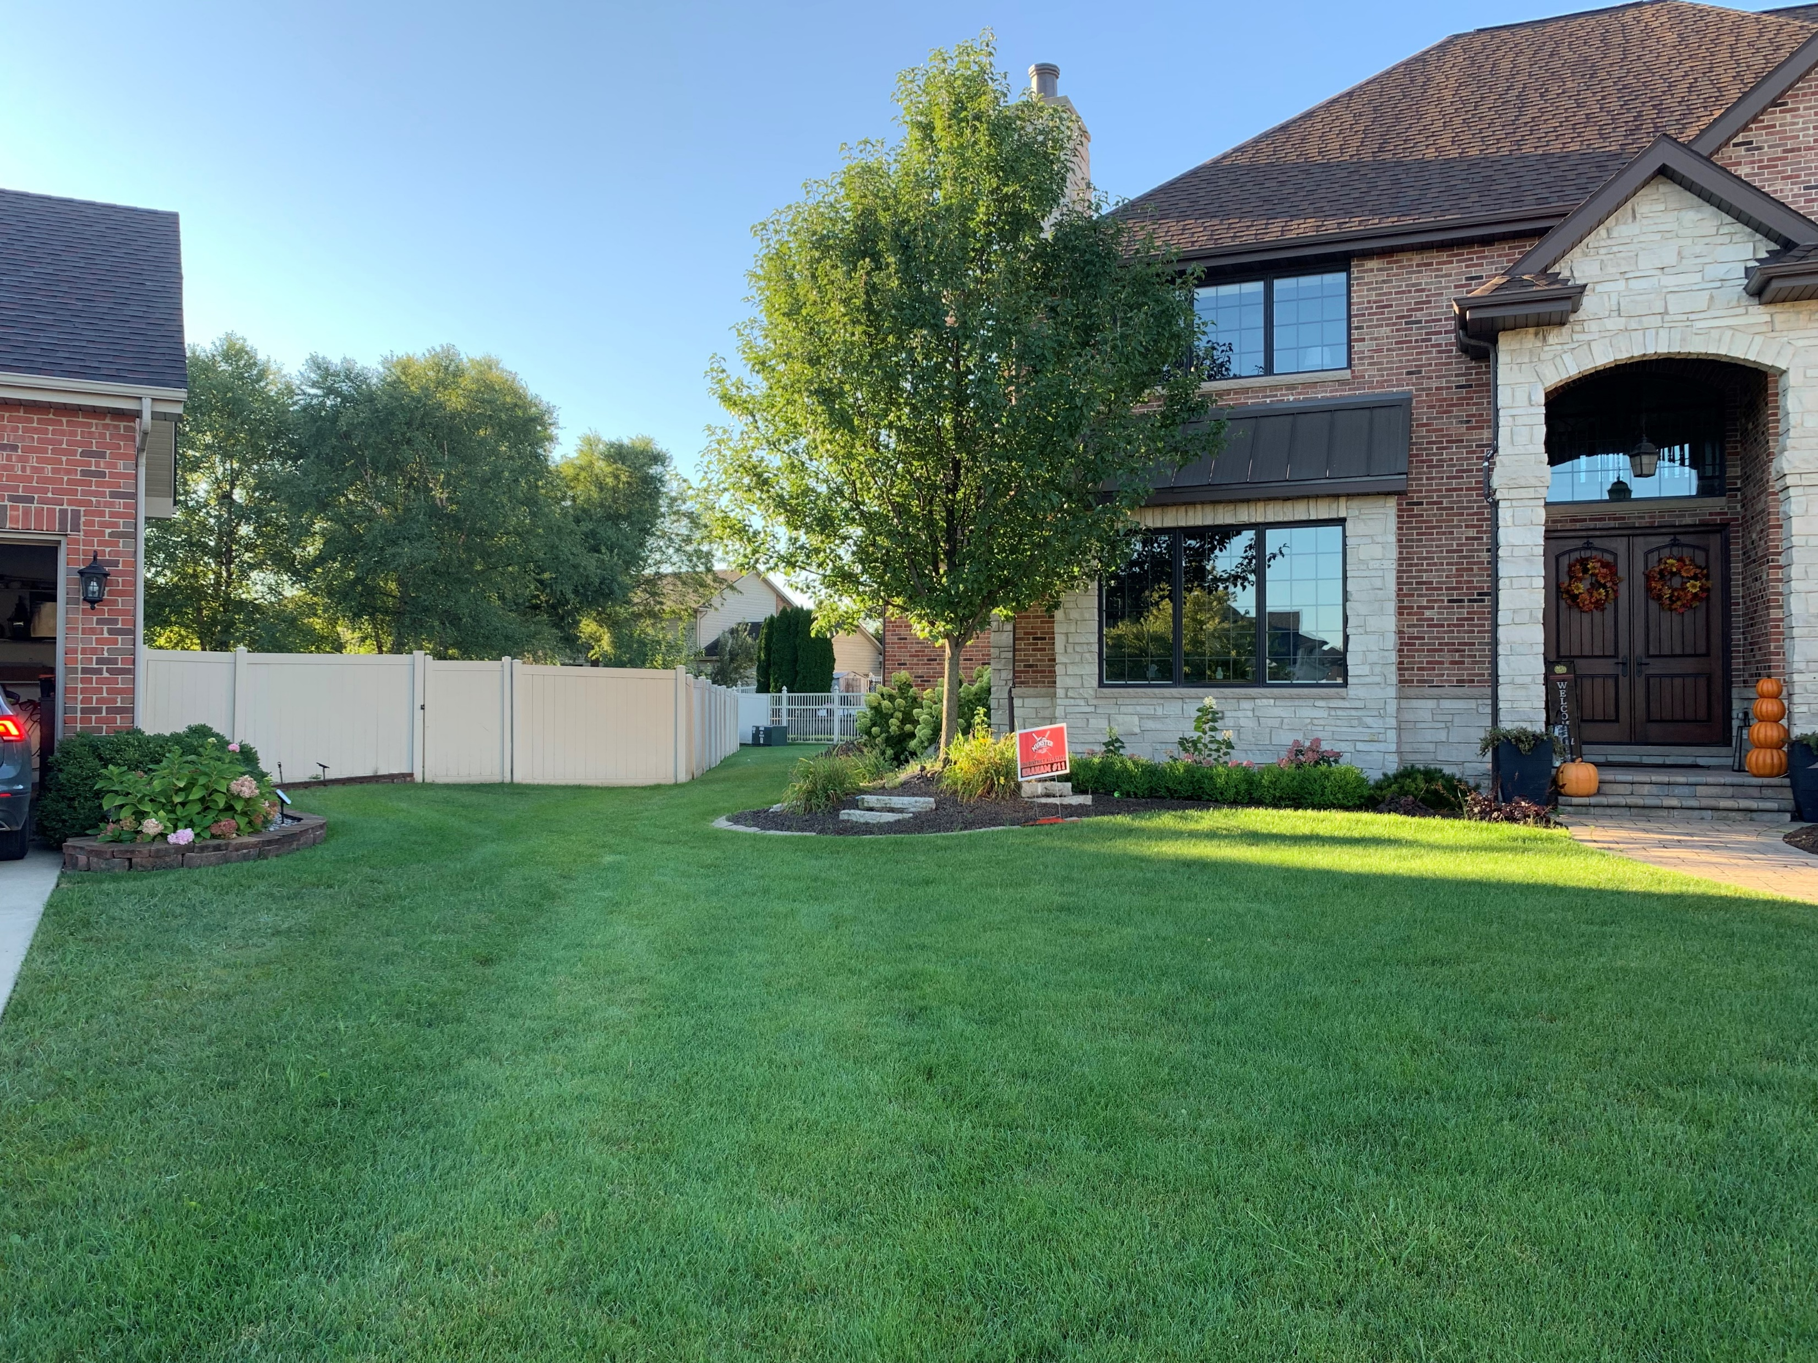

Slide 7
DEVELOPMENTAL VARIANCE
Approval will not be injurious to the public health, safety, morals and general welfare of the community
Use and value of the area adjacent to the property will not be affected in a substantially adverse manner
Strick application of the terms of the zoning ordinance will result in practical difficulties in the use of the property

Slide 8
Approval will not be injurious to the public health, safety, morals and general welfare of the community

Slide 9
Approval will not be injurious to the public health, safety, morals and general welfare of the community
Coverstar automatic covers use an exclusive, patented process to heat seal webbing around a polymer bead and weld it to the cover in one step. Independent lab tests show Coverstar’s webbing is over twice as strong as our competitors.
Coverstar fabric is made from specially formulated heavy-duty vinyl fabric for superior product performance. Our strong, durable top-of-the-line fabric offers these exclusive features:
Ultraviolet protection
Chemical resistance
Mildew resistance
Fabric strength (17 oz)
Tear resistance
Abrasion resistance
Minimal fabric shrinkage (less than 1%)

Slide 10
Approval will not be injurious to the public health, safety, morals and general welfare of the community
Pool covers are often more reliable than other safety equipment, like fences, because they create a barrier that directly seals your pool off. Even with a fence, if someone is able to get in the pool area, a pool cover will prevent them from entering the pool without your permission.
Coverstar fabric is made from specially formulated heavy-duty vinyl fabric for superior product performance. Our strong, durable top-of-the-line fabric offers these exclusive features:
Ultraviolet protection
Chemical resistance
Mildew resistance
Fabric strength (17 oz)
Tear resistance
Abrasion resistance
Minimal fabric shrinkage (less than 1%)

Slide 11
Approval will not be injurious to the public health, safety, morals and general welfare of the community
675 IAC 20-4-27 Safety features Authority: IC 22-13-2-2; IC 22-13-2-13 Affected: IC 22-12; IC 22-13; IC 22-15; IC 36-7 Sec. 27.
Access to residential pools shall be restricted by one (1) of the following means:
(1) Walls or fencing not less than five (5) feet high and completely surrounding the pool and deck area with the exception of self-closing and latching gates and doors, both capable of being locked.
(2) Other means not less than five (5) feet high and deemed impenetrable by the enforcing authority at the time of construction and completely surrounding the pool and deck area when the pool is not in use.
(3) A combination of subdivisions (1) and (2) that completely surrounds the pool and deck with the exception of self-closing and latching gates and doors which are capable of being locked. This applies to subdivisions (1) and (2) and this subdivision only.
(4) A power safety pool cover which shall: (A) provide a continuous connection between the cover and the deck, so as to prohibit access to the pool when the cover SWIMMING POOL CODE Indiana Administrative Code Page 45 is completely drawn over the pool; (B) be mechanically operated by a key or key and switch such that the cover cannot be drawn open or retracted without the use of a key; (C) is installed with track, rollers, rails, guides, or other accessories necessary to accomplish clauses (A) and (B), in accordance with the manufacturer's instructions; and (D) bear an identification tag indicating that the cover satisfies the requirements of ASTM F1346 for power safety pool covers

Slide 12
Use and value of the area adjacent to the property will not be affected in a substantially adverse manner

Slide 13
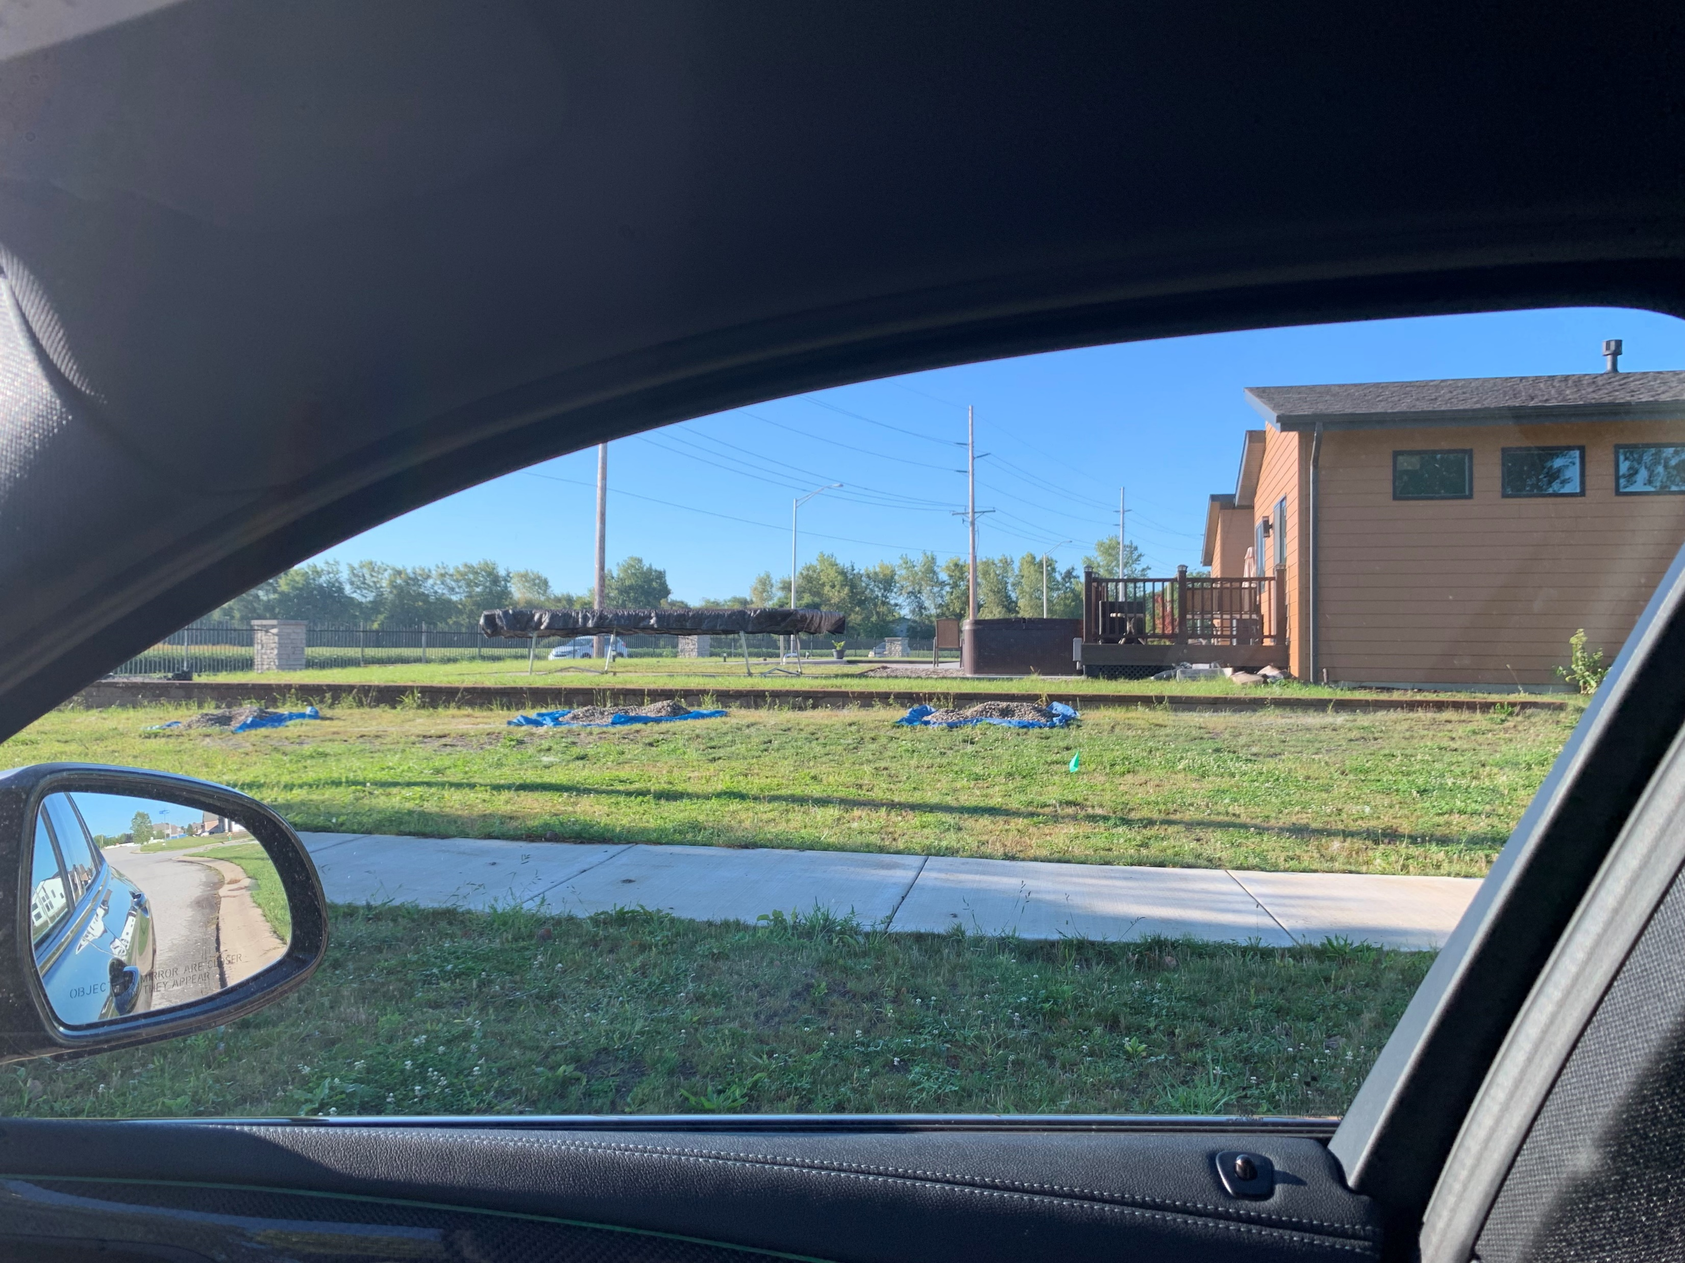
ROSEWOOD MEGAN WAY

Slide 14
Strick application of the terms of the zoning ordinance will result in practical difficulties in the use of the property
The “practical difficulties” standard is most commonly used in the context of area variances and is generally considered to be more relaxed than the unnecessary hardship standard applied to use variances.
Most communities allow covers instead of fences
Petitioner currently has difference fences enclosing 80% of his yard
Economic Impact
Not practical to install fence along with driveway, cannot cut off driveway
Having 4 different fences enclosing a backyard is not practical
There is a reasonable alternative to adding the fence

